Slide 1

HOTEL MANAGEMENT SYSTEM DATABASE PROJECT
Presented by : Group 4
Aswathi Bhojan (NF 1001601)
Aarmi Patel (NF 1002881)
Inderjeet kaur( NF1000 809)

Slide 2
PROJECT OVERVIEW
OBJECTIVE
Build a comprehension database for managing a hotel system.
Scope
Handle guest, booking, room, employee, payment, and feedback data.
Provide insights for business and machine learning.
KEY HIGHLIGHTS
Fully Normalized database schema.
Advanced SQL queries demonstrating mastery of DDL, DML, DQL.

Slide 3
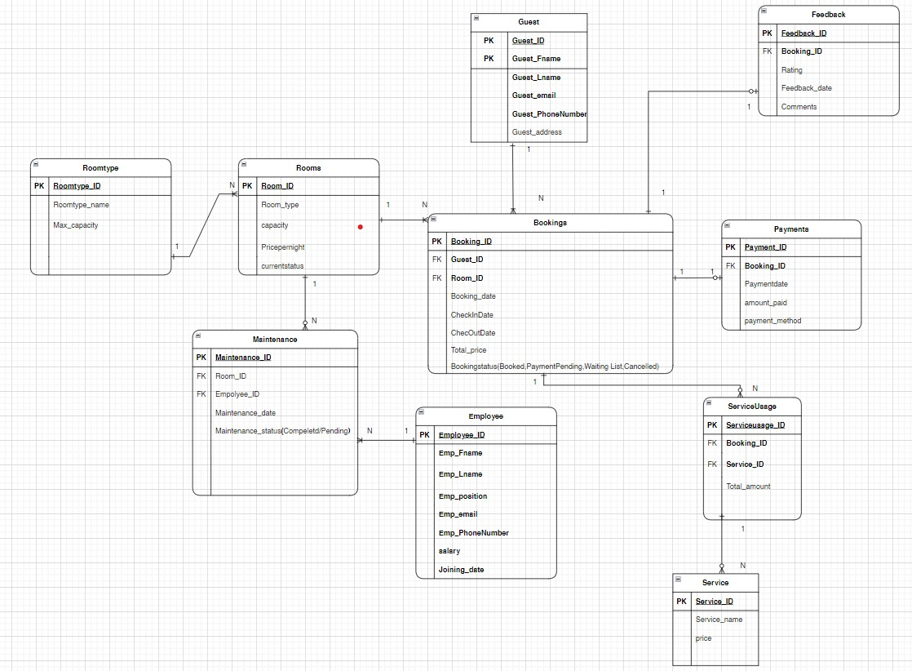
ER Diagram

Slide 4

SCHEMA DESIGN
Key Points
10 interrelated tables to minimize redundancy and ensure data integrity.
Constraints : Primary keys, Foreign keys, unique, Not null and ENUM constraints.
EXAMPLE SCHEMA
CREATE TABLE Guest (
Guest_ID int PRIMARY KEY , UNIQUE, NOT NULL,
Guest_Fname VARCHAR(50) NOT NULL
);

Slide 5
TYPES | PRIMARY KEY | FOREIGN KEY
Guest | Guest_ID
Rooms | Room_ID
Room Type | Room type_ID
Bookings | Booking_ID | Guest_ID, Room_ID
Employee | Employee_ID
Payments | Payment_ID | Booking_ID
Service | Service_ID
Service Usage | Service Usage_ID | Service_ID, Booking_ID
Feedback | Feedback_ID | Booking_ID
Maintenance | Maintenance_ID | Room_ID, Employee_ID
PRIMARY KEY AND FOREIGN KEY

Slide 6
RELATIONSHIP BETWEEN TABLES
 | One to many (Mandatory) | One to many (Optional) | One to one (Optional) | Many to one (Mandatory)
GUEST | Bookings
ROOMS | Bookings
ROOMS |  |  |  | ROOM_TYPE
BOOKINGS |  |  | Payments
BOOKINGS |  |  | Feedback
BOOKINGS |  | Service Usage
ROOMS |  | Maintenance
EMPLOYEE | Maintenance
SERVICE |  | Service Usage

Slide 7
DATA MANIPULATION (DML)
INSERT
Add realistic data (example, adding a guest and booking).
UPDATE
Modify a guest's contact information or update room status.
DELETE
Remove outdated records (example, completed maintenance tasks).

Slide 8

DATA RETRIEVAL (DQL)
SIMPLE QUERY
List all rooms available for booking.
ADVANCED QUERY
Subquery: Guests spending above average
Aggregate functions : Total earnings per room type.
Window functions : Cumulative payments per guest.

Slide 9
KEY INSIGHTS FOR MACHINE LEARNING
Predictive models for customer retention (Guest and feedback data)
Revenue forecasting (Payments and bookings data).
Optimize room pricing (Occupancy rate and earnings)

Slide 10
CHALLENGES AND LEARNINGS
CHALLENGES
Ensuring normalization
Handling optional relationships effectively.
LEARNINGS
Enhanced SQL skills.
Deeper understanding of database design.

Slide 11
CONCLUSION
The Hotel Booking Management System project represents a significant step toward streamlining hotel operations, improving customer satisfaction, and enhancing overall efficiency.
KEY ACHIEVEMENT :
Real-time tracking of room availability and bookings.
Features such as booking modifications and cancellations improved customer convenience.
Centralized database ensured accuracy and consistency in managing customer, room, and
payment records.
Utilized SQL queries to insert, update, delete, and retrieve data, showcasing the use of Data Manipulation
Language (DML) effectively.
Implemented appropriate constraints, such as primary keys, foreign keys, and unique constraints, to
ensure referential integrity and data consistency.

